Slide 1
COE 381 – Micro Processors Project
Project Title : Speed Monitoring System
Presented By: GROUP 2
ANNAN OTINKORAN JACOB - 1871822
MIGHTY AKUFFO - 1871322
KAMAS ABNER - 1872822
SARKODIE KWABENA RICHARD - 1874322
AKWULPWA FELIX WEPABURA - 1871422
Supervised By: T.A Abraham

Slide 2
Table of Contents
1. Problem Statement
2. Methodology
3. Components & Code Snippets
4. Code: Setup & Initialization
5. Code: Speed Detection
6. Conclusion

Slide 3
Problem Statement
Issue: Over-speeding is a major cause of road accidents.
Objective: Develop a speed monitoring system simulation using IR sensors to detect vehicles exceeding the speed limit.
Significance: Helps improve road safety and traffic management.

Slide 4
Methodology
Approach:
- Placement of two IR sensors at a fixed distance apart.
- Capturing the time taken for a vehicle to move between the sensors.
- Calculating speed using Speed = Distance / Time.
Software Used:
- Tinkercad Simulator for virtual testing.

Slide 5
Components & Code Overview
Component List:
1. Arduino Uno R3 (U1) - Microcontroller
2. PIR Sensors (PIR1, PIR2) - Detects vehicle movement
3. Pushbutton (S1) - Resets the system
4. Piezo Buzzer (PIEZO4) - Alerts for overspeeding
5. Resistors (R1, R2) - Circuit stabilization
6. Green LED (D1) - Indicates safe speed.

Slide 6
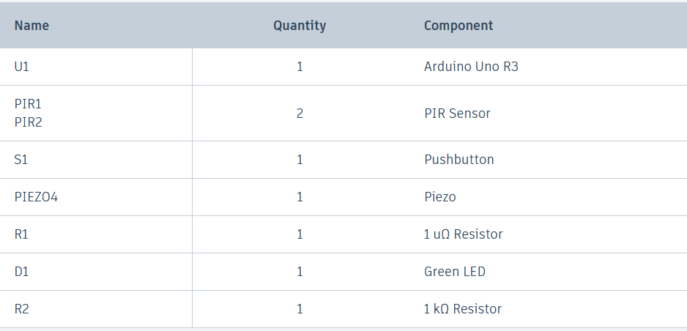
Component List

Slide 7
Schematic Diagram

Slide 8
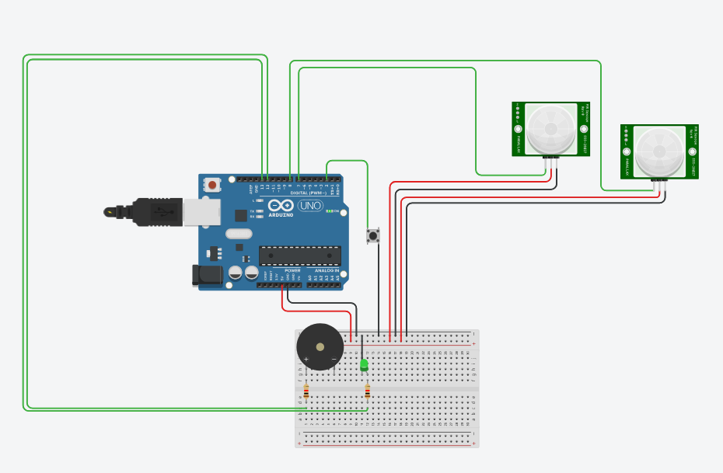
Project Implementation - Diagram

Slide 9
Code: Setup & Initialization
void setup() {
Serial.begin(9600);
pinMode(sensor1_pin, INPUT_PULLUP);
pinMode(sensor2_pin, INPUT_PULLUP);
pinMode(reset_pin, INPUT_PULLUP);
pinMode(overspeed_pin, OUTPUT);
pinMode(safespeed_pin, OUTPUT);
}

Slide 10
Explanation: Code Setup
This section of the code initializes the pins and serial communication for debugging:
- `Serial.begin(9600)`: Starts serial communication at 9600 baud rate.
- `pinMode(sensorX_pin, INPUT_PULLUP)`: Sets up IR sensor pins as input with pull-up resistors.
- `pinMode(overspeed_pin, OUTPUT)`: Sets up the overspeed alert as an output.

Slide 11
Code: Speed Calculation
if (digitalRead(sensor1_pin) == HIGH && !sensor1_triggered) {
time1 = millis();
sensor1_triggered = true;
}
if (digitalRead(sensor2_pin) == HIGH && sensor1_triggered && !sensor2_triggered) {
time2 = millis();
sensor2_triggered = true;
float time_sec = (time2 - time1) / 1000.0;
float speed_kmh = (distance_m / time_sec) * 3.6;
}

Slide 12
Explanation: Speed Calculation Code
This code calculates the vehicle's speed based on sensor readings:
- When `sensor1_pin` detects a vehicle, `time1` is recorded.
- When `sensor2_pin` detects the vehicle passing the second sensor, `time2` is recorded.
- The time difference (`time2 - time1`) is used to calculate speed in km/h, considering distance between the sensors.

Slide 13
Code: Speed Alert
if (speed_kmh > SPEED_LIMIT) {
digitalWrite(overspeed_pin, HIGH);
digitalWrite(safespeed_pin, LOW);
} else {
digitalWrite(overspeed_pin, LOW);
digitalWrite(safespeed_pin, HIGH);
}

Slide 14
Explanation: Speed Alert Code
The speed alert code triggers the appropriate action based on vehicle speed:
- If the speed exceeds the `SPEED_LIMIT`, the overspeed buzzer is activated and the green LED is turned off.
- If the speed is within the limit, the green LED is lit, and the buzzer is turned off.

Slide 15
Conclusion
Findings:
- The simulation successfully detects vehicle speed.
- Overspeed alerts are triggered accurately.
Challenges:
- Accuracy in virtual simulation vs real-world response.
Future Improvements:
- Adding real-time displays for speed output.
- Implementing physical hardware testing.

Slide 16
THANK YOU

